Slide 1
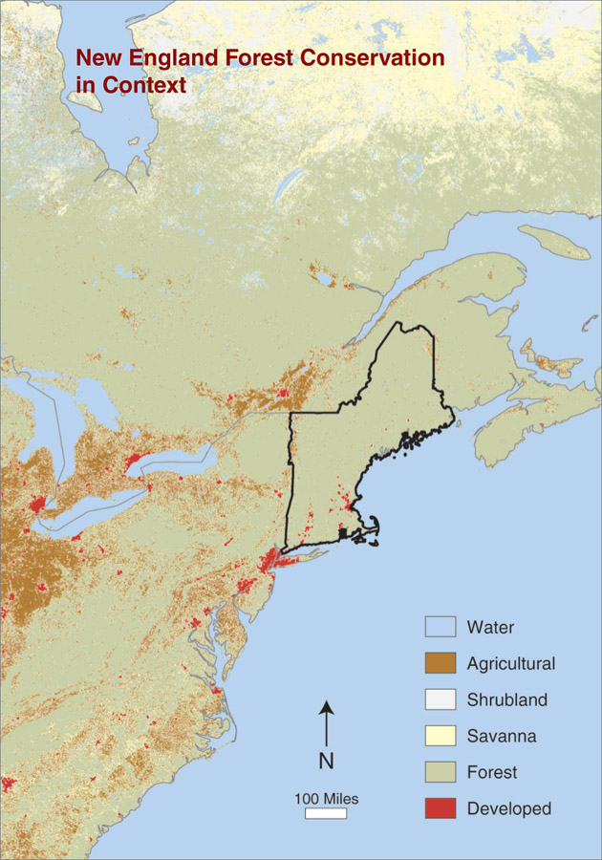
Fostering prescient thinking through Science-Stakeholder Partnerships
Jonathan Thompson
Joint Sino-US Workshop
on Forest, Soil, and Landscape Modeling
June, 2015

