Slide 1
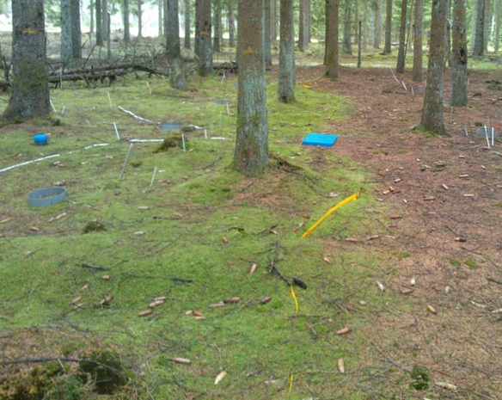
Effects of two decadal N addition on C and N cycling in a spruce forest in Denmark
Per Gundersen
Section for Forest, Nature and Biomass
Dept. of Geosciences and Natural Resource Management
University of Copenhagen

Slide 2
