Slide 1
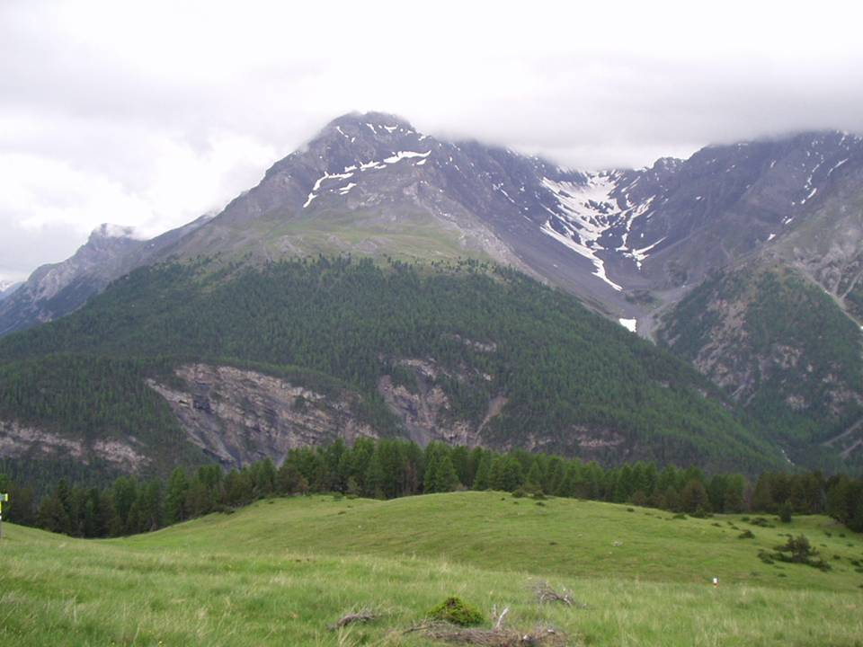
large-scale investigation reveals a winter carbon limitation in roost
Alpine Treeline Formation:
Mai-He LI
Swiss Federal Research Institute WSL
maihe.li@wsl.ch
Notes:
Here I would like to discuss the physiological mechanisms of the alpine treeline formation. Namely, which physiological responses to low temperature lead to the Alpine treeline phenomenon?

