Slide 1
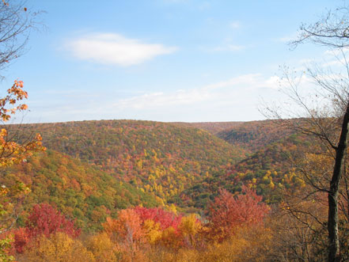
Modeling landscape and climate effects on forest bird habitat and populations in the Midwestern U.S.
Frank R. Thompson III
U.S. Forest Service Northern Research Station
and University of Missouri

